Slide 1

Object-oriented Programming with Ruby
Robert Batzinger
CSCI A-201
Spring 2009

Slide 2
Variables in Ruby:
Working with data in memory

Slide 3
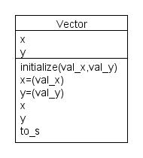
Vector class
Methods Examples
Model
Constructor
v = Vector.new(1,2)
Setter Methods
v.x = 5
v.y = 10
Accessor Methods
x = v.x
y = v.y
Display/Format Method
puts v

Slide 4
Why use variables?
Allows us to store information in memory
By assignment
x = 5
Through setter methods of a class
v1.x = 17
v1.update_x(17)
Allow us to check the value of stored data
By reference puts x
By accessor methods of a class
puts v1.x

Slide 5
4 types of variables in Ruby
Local variable (active within local block of code) name = ’bob’
Global variable (active in every context) Name = ’bob’
Instance variable (active within methods of a single object) @name = ’bob’
Class variable (active within all methods of all objects of the class) @@name = ’bob’

Slide 6
2 Types of Constants
Symbols (local immutable values)
:up, :down, :left, :right
Global Constants (global immutable values)
PI = 3.14159

Slide 7
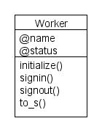
An example
OFFICE = ' GTF Services'
class Worker
attr_reader :name, :status
@@count = 0
def initialize(name)
@name = name
@status = :out
@@count += 1
end
def signin
@status = :in
end
def signout
@status = :out
end
def to_s
"#{@name}: #{@status}"
end
end

Slide 9
End of lecture

